Slide 1

OpenEscrow
Trustless, Transparent & Decentralized Escrow System
Secure transactions without trusting intermediaries
Presented by: Your Name / Team Name College / Event Name

Slide 2
What is Escrow?
Neutral Holding Mechanism
Bridging Trust Gaps
Conditional Release
Used when two parties don’t fully trust each other
Funds are released only when predefined conditions are met
Escrow is a neutral holding mechanism for funds or assets
Examples:
Freelance payments
Online marketplaces
Digital asset transactions
High-value peer-to-peer deals

Slide 3
Problems with Traditional Escrow Systems
Centralized Intermediaries
High Service Fees
Slow Settlement Times
Lack of Transparency
Manual Dispute Resolution
Risk of Fraud or Misuse
Requires Trust in a Third Party

Slide 4






The Need for OpenEscrow
Growing Digital & Cross-Border Transactions
Web3 & Crypto Adoption
Demand for Trustless Systems
Need for Automation & Transparency
Users Want Control Over Their Funds

Slide 5

What is OpenEscrow?
OpenEscrow is a:
Decentralized escrow platform
Built on blockchain technology
Uses smart contracts to automate trust
Open, transparent & verifiable by anyone
No middlemen. Code enforces trust.

Slide 6




Core Idea
Funds Locked
Conditions Defined
Funds are locked in a smart contract
Conditions are defined at escrow creation
Automatic Release
Dispute Handling
Funds release automatically when conditions are met
Disputes handled via on-chain mechanisms

Slide 7
Key Features
Smart Contract–Based Escrow
Transparent Transactions
Multi-Party Involvement
Dispute Resolution System
Wallet-Based Authentication
Immutable Records
Open-Source Architecture

Slide 8
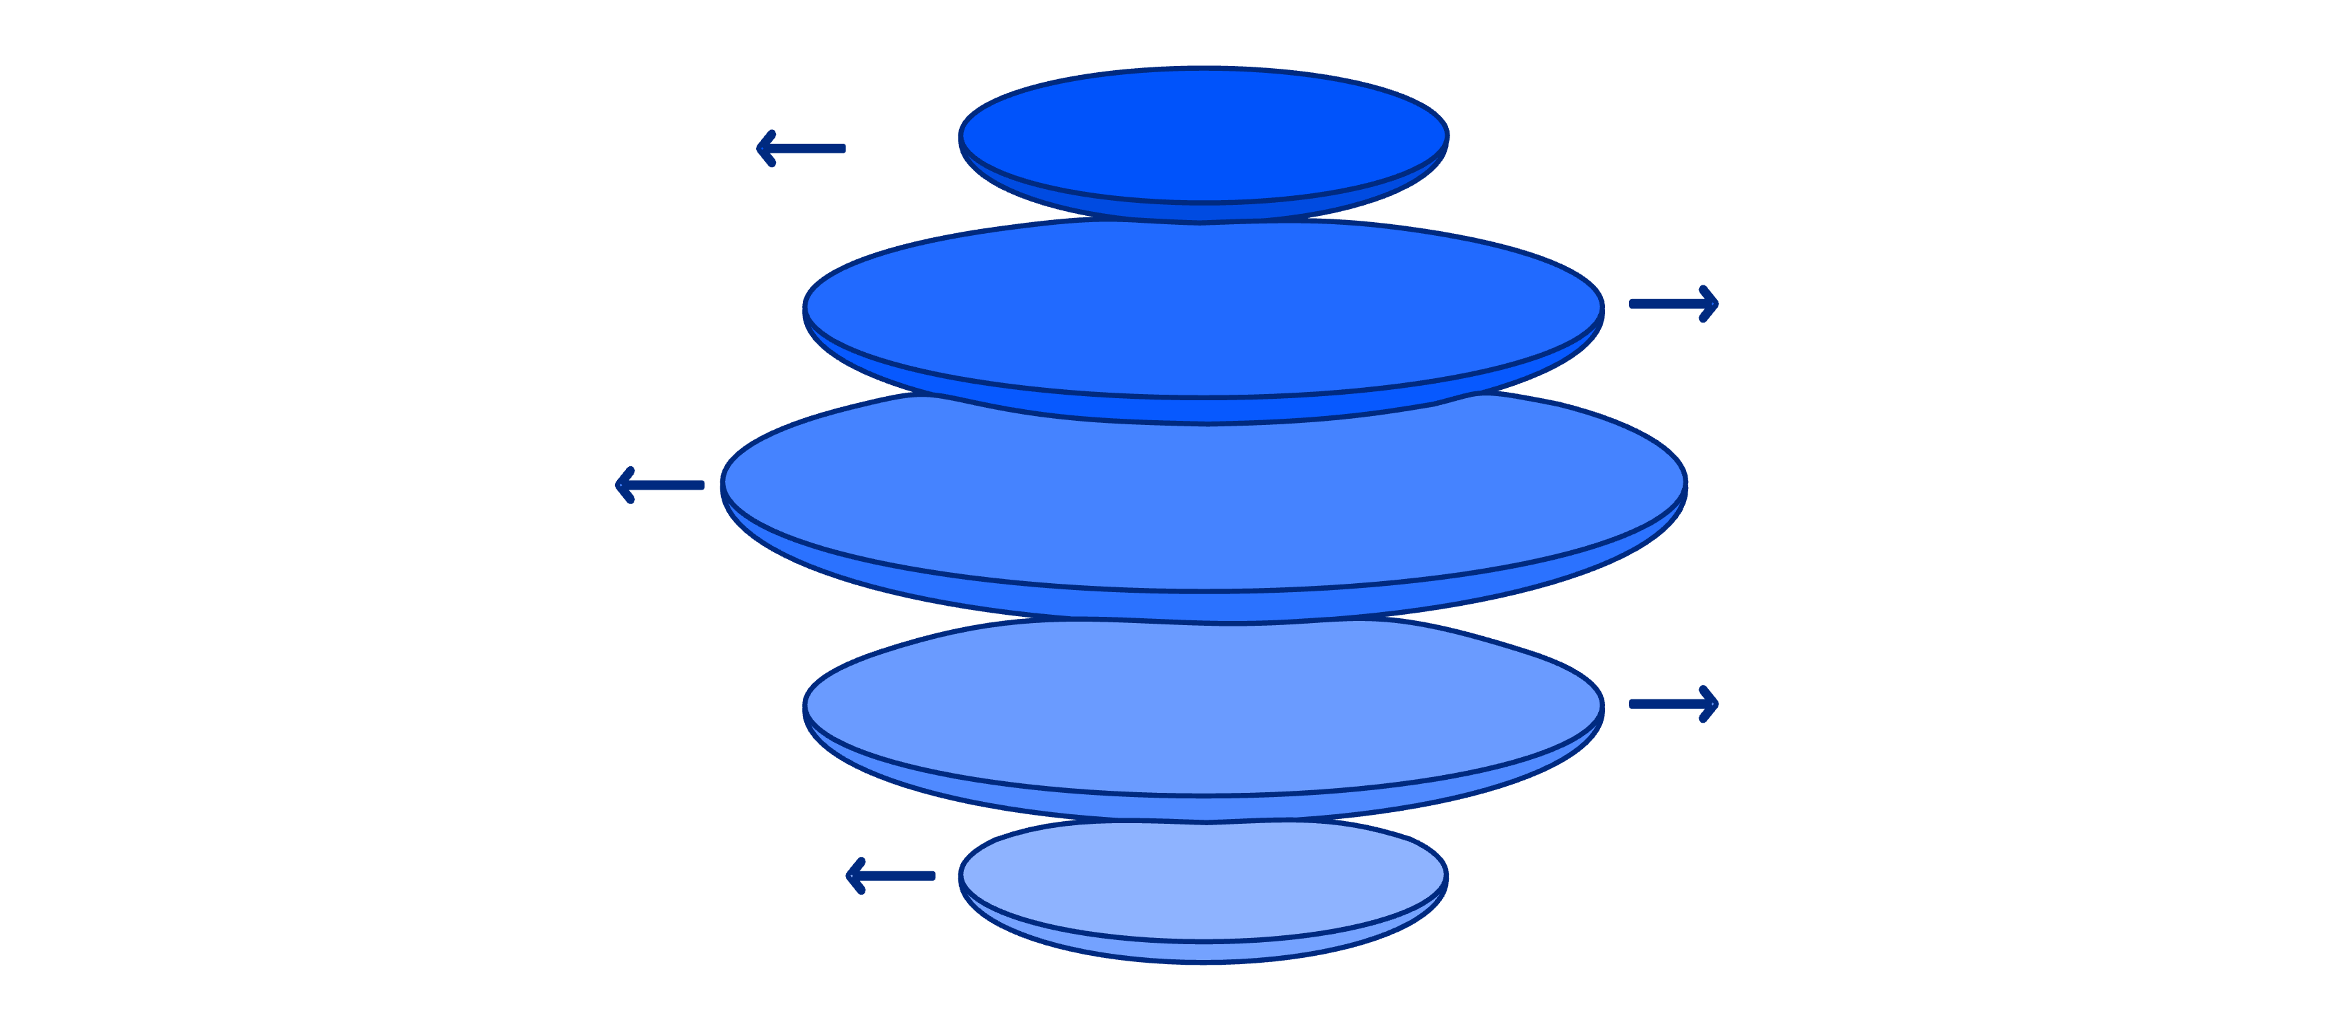
How OpenEscrow Works (Flow)
Create Contract
Buyer initiates an escrow agreement
Deposit Funds
Buyer transfers payment into escrow
Complete Delivery
Seller fulfills the task or delivery
Confirm Receipt
Buyer verifies completion and approves
Release or Dispute
Smart contract pays or triggers arbitration

Slide 9
Smart Contracts in OpenEscrow
Automatically Enforce Rules
No Human Intervention Needed
Tamper-Proof Logic
Fully Auditable
Eliminates Bias and Corruption

Slide 10
User Roles
BUYER
SELLER
deposits funds
delivers goods/services
ARBITRATOR (OPTIONAL)
PLATFORM
resolves disputes
provides UI, not custody

Slide 11

Dispute Resolution Mechanism
1
2
3
Triggered when buyer/seller disagree
Evidence submission (files, messages, hashes)
Community or assigned arbitrator voting
4
5
Majority decision releases funds
All actions recorded on-chain

Slide 12
Transparency & Trust
Every transaction is publicly verifiable
Funds can’t be misused or frozen unfairly
No hidden fees
No platform manipulation
Trust shifts from people → code

Slide 13





Security Architecture
Blockchain immutability
Smart contract audits
Wallet-based identity (no passwords)
Cryptographic verification
Non-custodial fund handling

Slide 14
Tech Stack (Example)
Frontend
Blockchain
React / Next.js
Ethereum / Polygon
Tailwind / Material UI
Solidity smart contracts
Backend
Wallets
Node.js (API layer)
MetaMask / WalletConnect
IPFS (file storage)

Slide 15
Use Cases
Freelancing platforms
NFT & digital asset sales
Real estate token transactions
Cross-border payments
Marketplace transactions
Startup funding milestones

Slide 16
Advantages of OpenEscrow
No central authority
Lower transaction costs
Faster settlements
Global accessibility
Censorship-resistant
Highly scalable

Slide 17
Comparison
Traditional Escrow vs OpenEscrow
Centralized
Decentralized
High fees
Low fees
Manual process
Automated
Opaque
Transparent
Trust-based
Code-based

Slide 18

Challenges & Limitations
Smart contract bugs
User education needed
Legal recognition varies
Gas fees on some chains
Dispute arbitration complexity

Slide 19
Future Enhancements
AI-assisted dispute resolution
1
DAO-based arbitration
2
Multi-chain support
3
Reputation scoring system
4
Fiat on/off ramps
5
Mobile app support
6

Slide 20




Why OpenEscrow Matters
Redefines trust in digital transactions
Empowers users globally
Removes dependency on intermediaries
Aligns with the decentralized future

Slide 21
Conclusion
OpenEscrow provides:
Trust without intermediaries
Secure, transparent transactions
Scalable and global escrow solution
“In code we trust.”

Slide 22

Thank You

